Slide 1


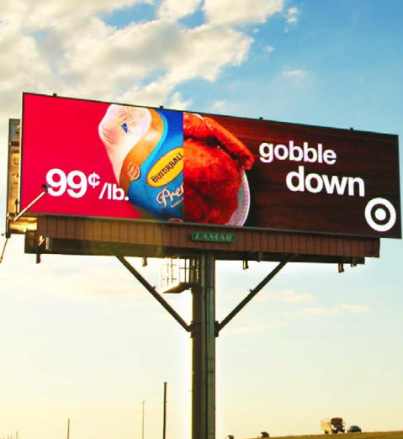
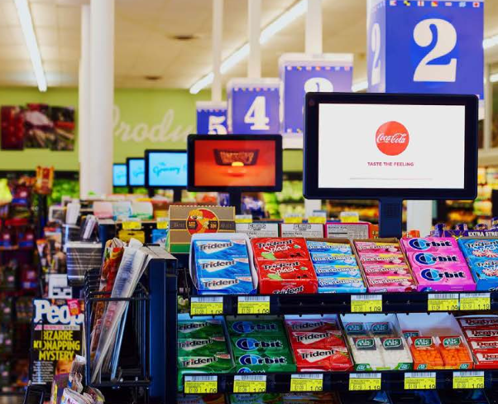
DIGITAL OUT OF HOME ADVERTISING
What is digital out of home?
Digital out of home (DOOH) is a high impact, eye-catching advertising strategy encouraging brands to digitize their ads and display content easily accessible to the general public. From highway billboards to elevators, malls to universities, subways to supermarkets, and arenas to street corners and more! DOOH offers massive reach and 100% viewable experiences woven into consumers’ daily journeys between home, work, shopping, and entertainment.
How does it work?
Using digital out of home advertising ensures that your ads are reaching more than a 1:1 audience by instead, reaching groups of highly desirable consumers all at the same time in high impact moments. Your ads are always viewable with no ad blocking. Optimize your campaigns using eye catching creative, weather segments, venue type, time of day & more. Geo targeting includes zip codes, cities/DMAs, and states. DOOH allows you to reach and influence your audience in non-traditional avenues.
What are the benefits?
Digital out of home offers superior benefits for advertisers including:
Massive reach
High-impact, human-scale creative
Retail proximity
No fraud, guaranteed brand safety
100% viewability with no ad blocking
EXAMPLES OF DIGITAL OUT OF HOME

